Slide 1

Online IDE
AWT05

Slide 2
Online IDE (Integrated Development environment)
Needs to run java
Needs to run python
Will be developed in two phases

Slide 3
Problems:
How to compile diferent languages
How to run diferent languages
How to communicate with a web user

Slide 4
We decided:
Code in java
Use spring
Swagger
Hibernate / JPA
Tokens

Slide 5
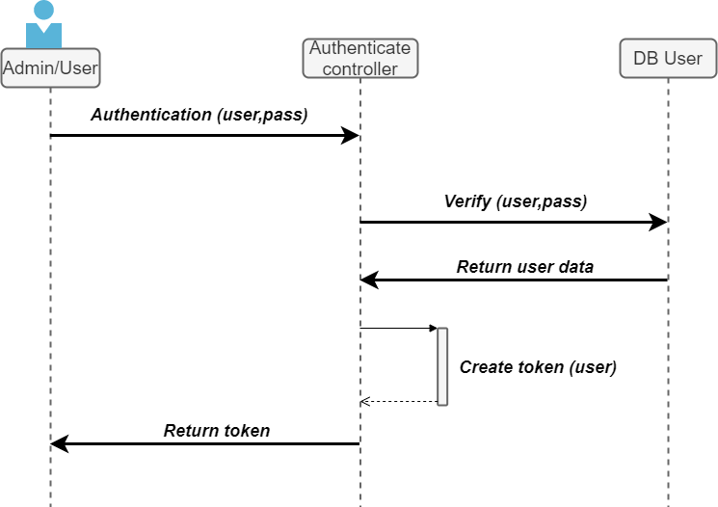
Authenticate

Slide 6
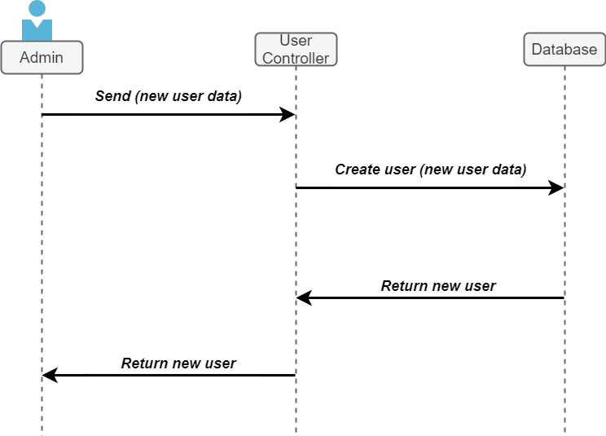
Create user

Slide 7
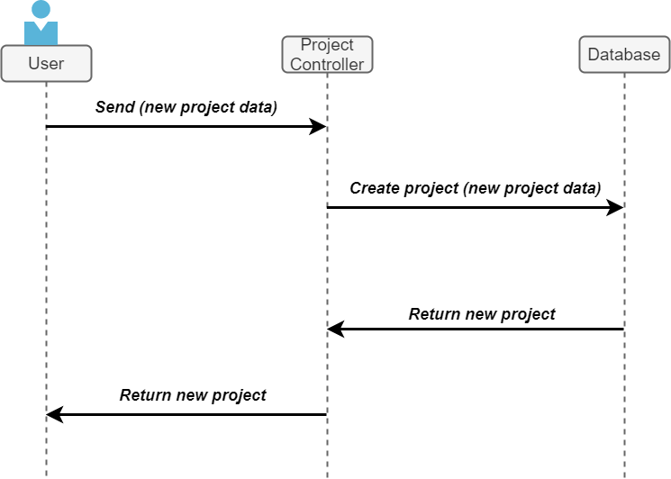
Create new project

Slide 8
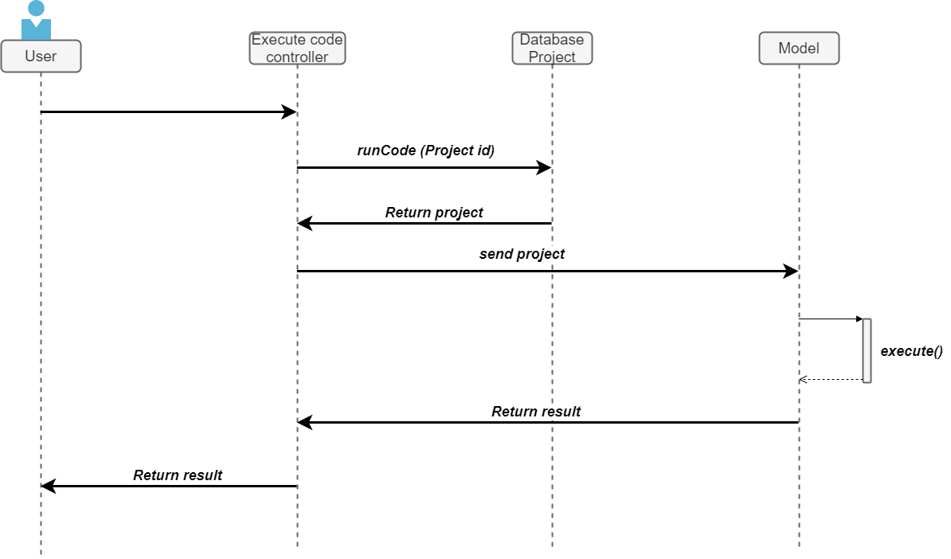
Execute

Slide 9
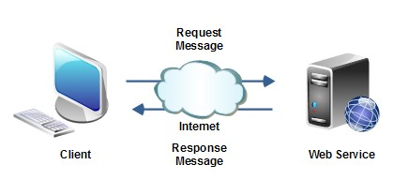
Web Service
Using:
Java Spring for build a RESTful web service.
Gradle as a building tool.
Git as a code versioning control system

Slide 10

Spring Boot
Spring Boot is an open source Java-based framework used to create micro Services.

Slide 11
REST Service(Representational State Transfer)
Most important operations(used in the actual project):
POST to create information
GET to read information
PUT to update information
DELETE to delete information
Other operations:
OPTIONS, TRACE, CONNECT

Slide 12
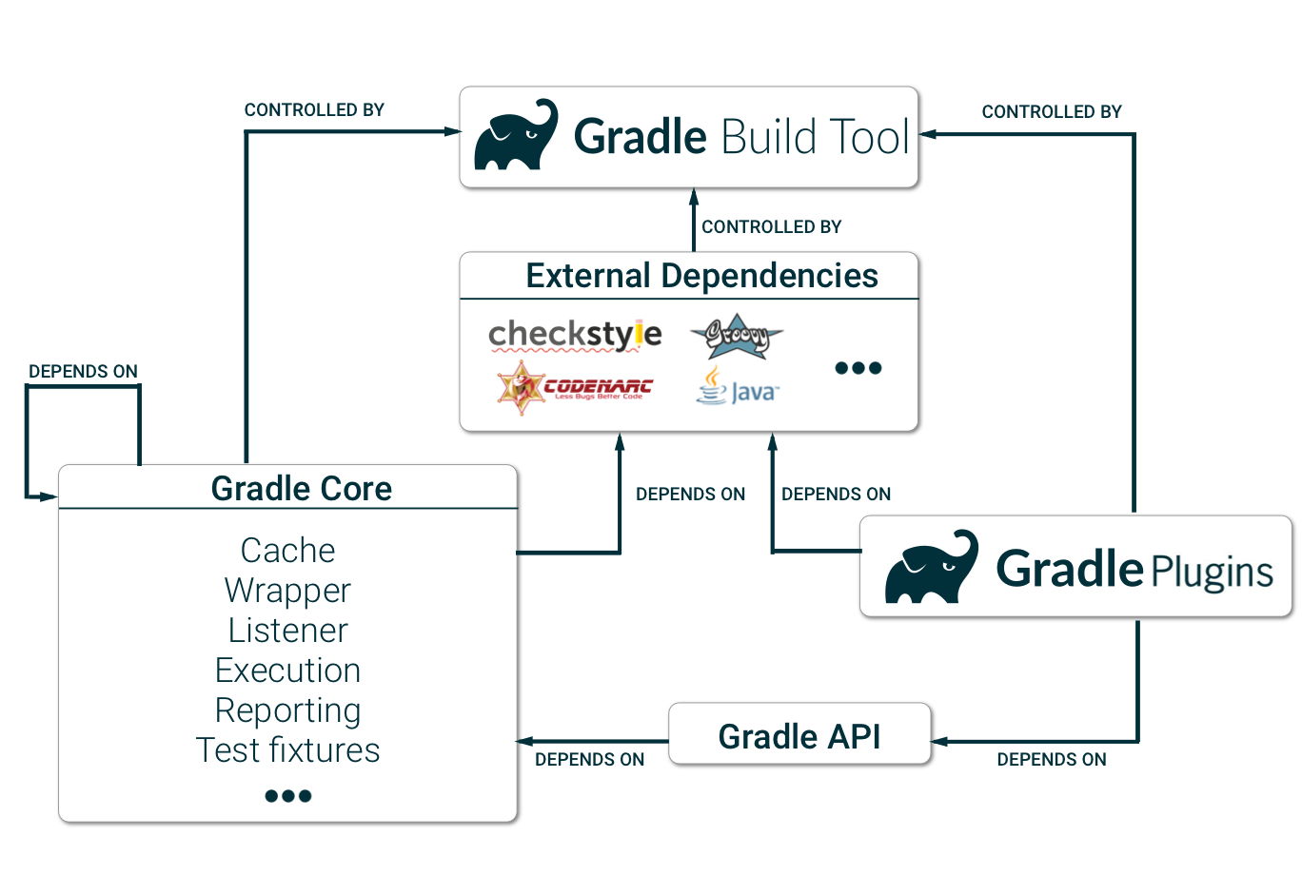
Gradle
Gradle is an open source build automation tool focused on flexibility and performance.

Slide 13
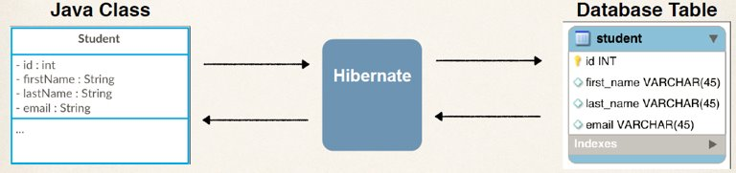
Hibernate / JPA(Java Persistence API)

Slide 14
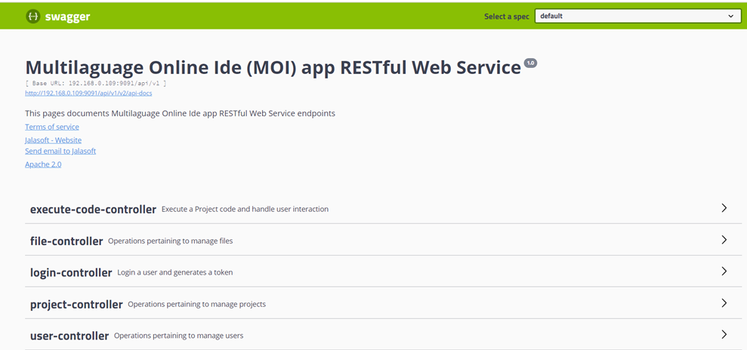
Controller ( Config)
Swagger

Slide 15
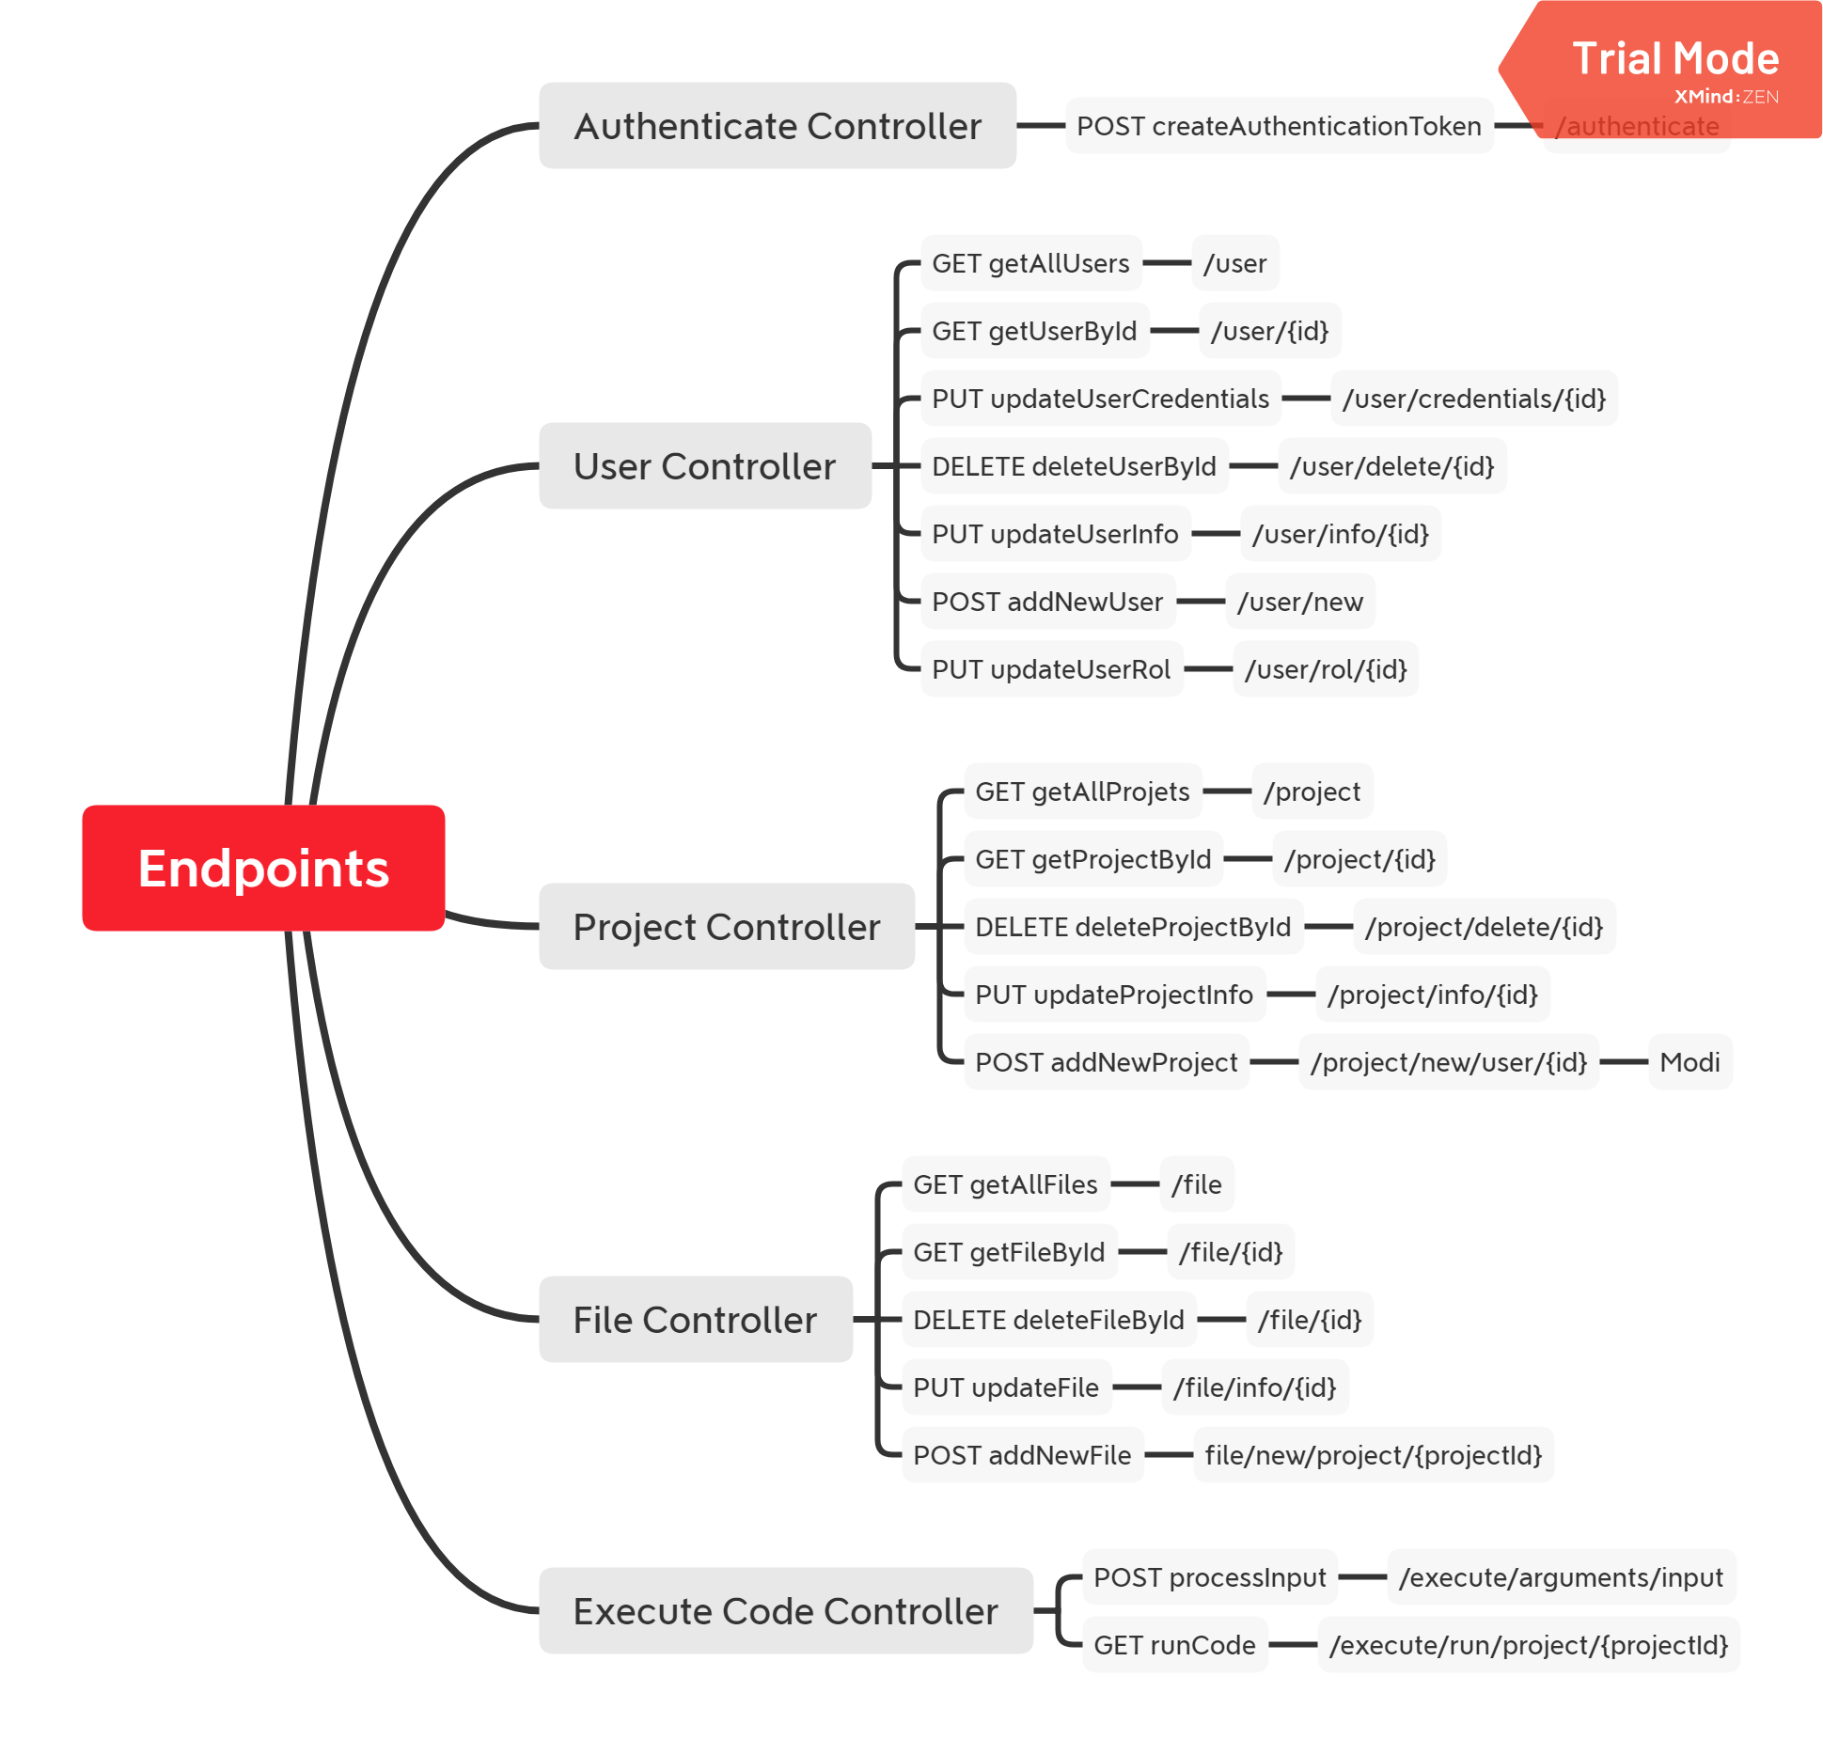
Endpoint summary

Slide 16
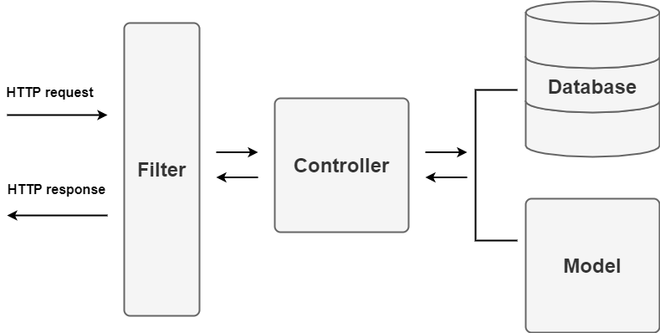
Project Architecture

Slide 17
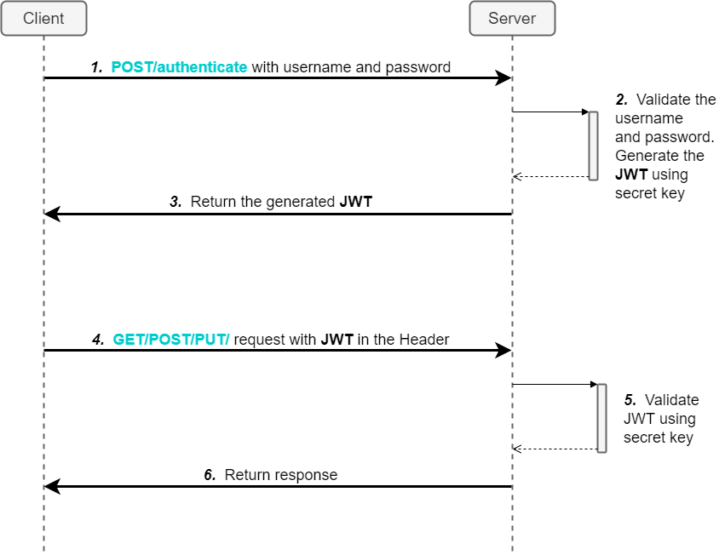
Filter Process

Slide 18
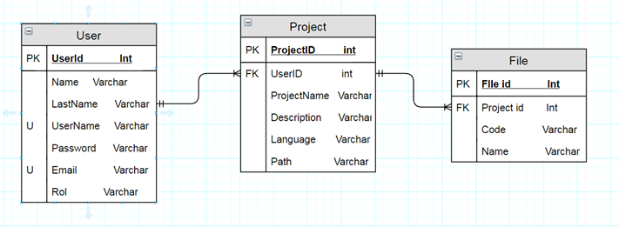
Data Base ( Domain )

Slide 19
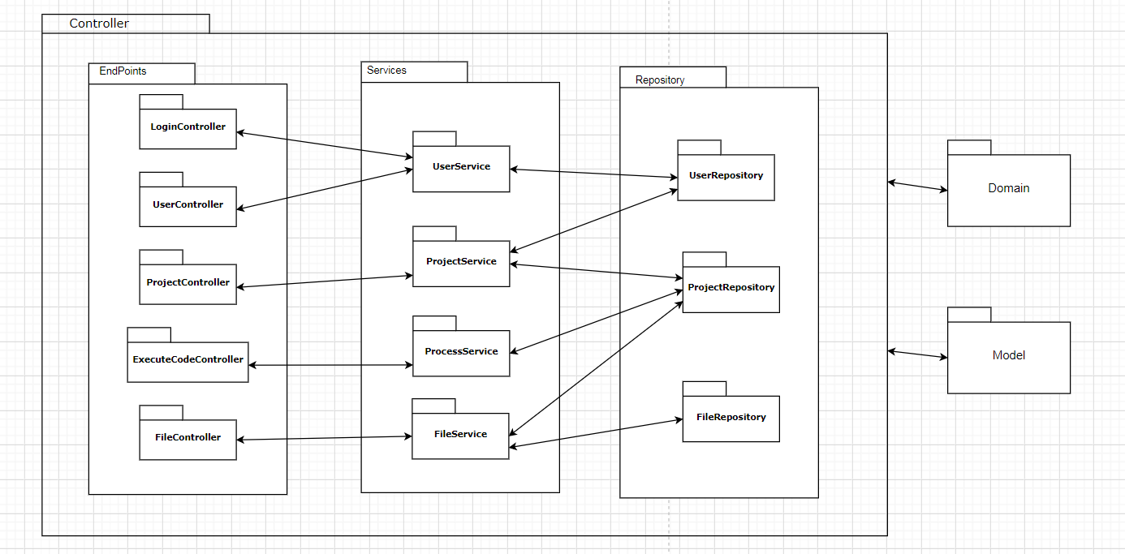
Controller

Slide 20
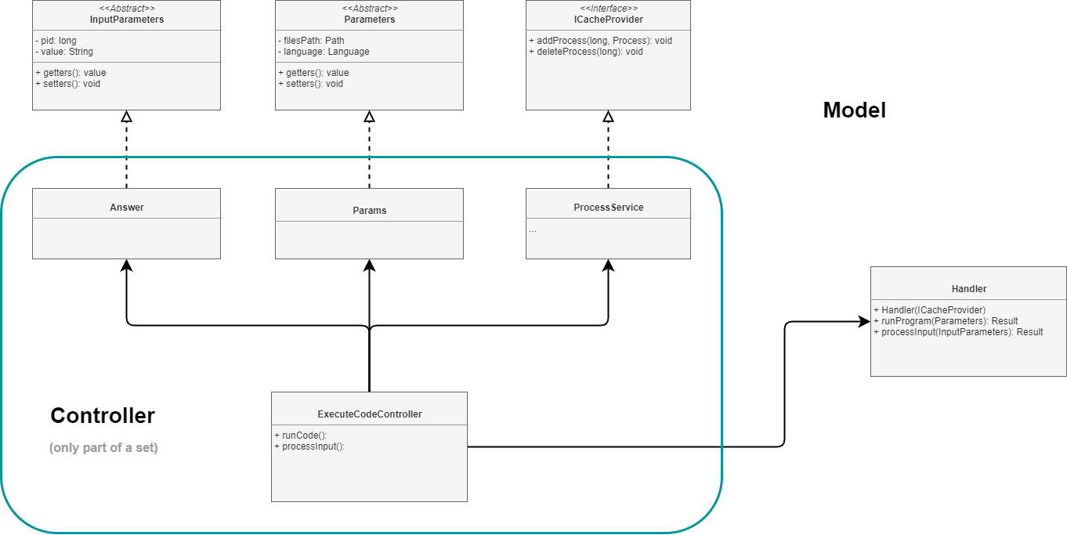
Communication with Model

Slide 21
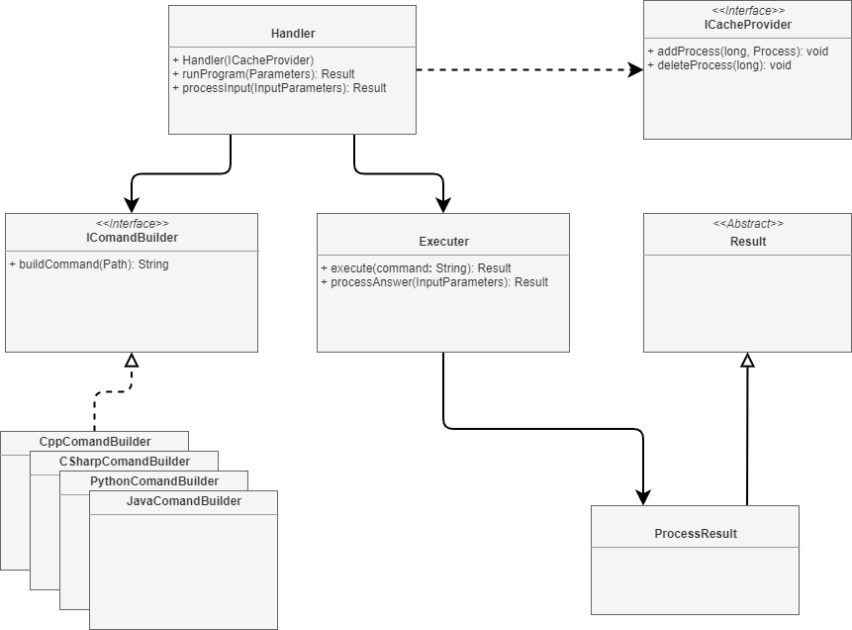
Model

Slide 22
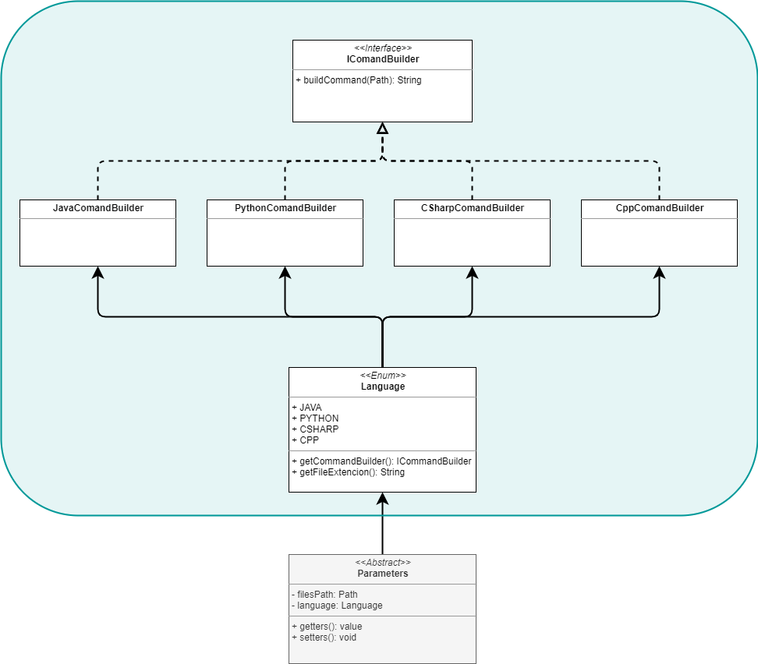
Model Parameters and Command Builder

Slide 23
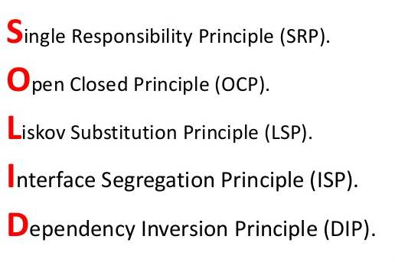
SOLID Principles
S
O
L
I
D

Slide 24
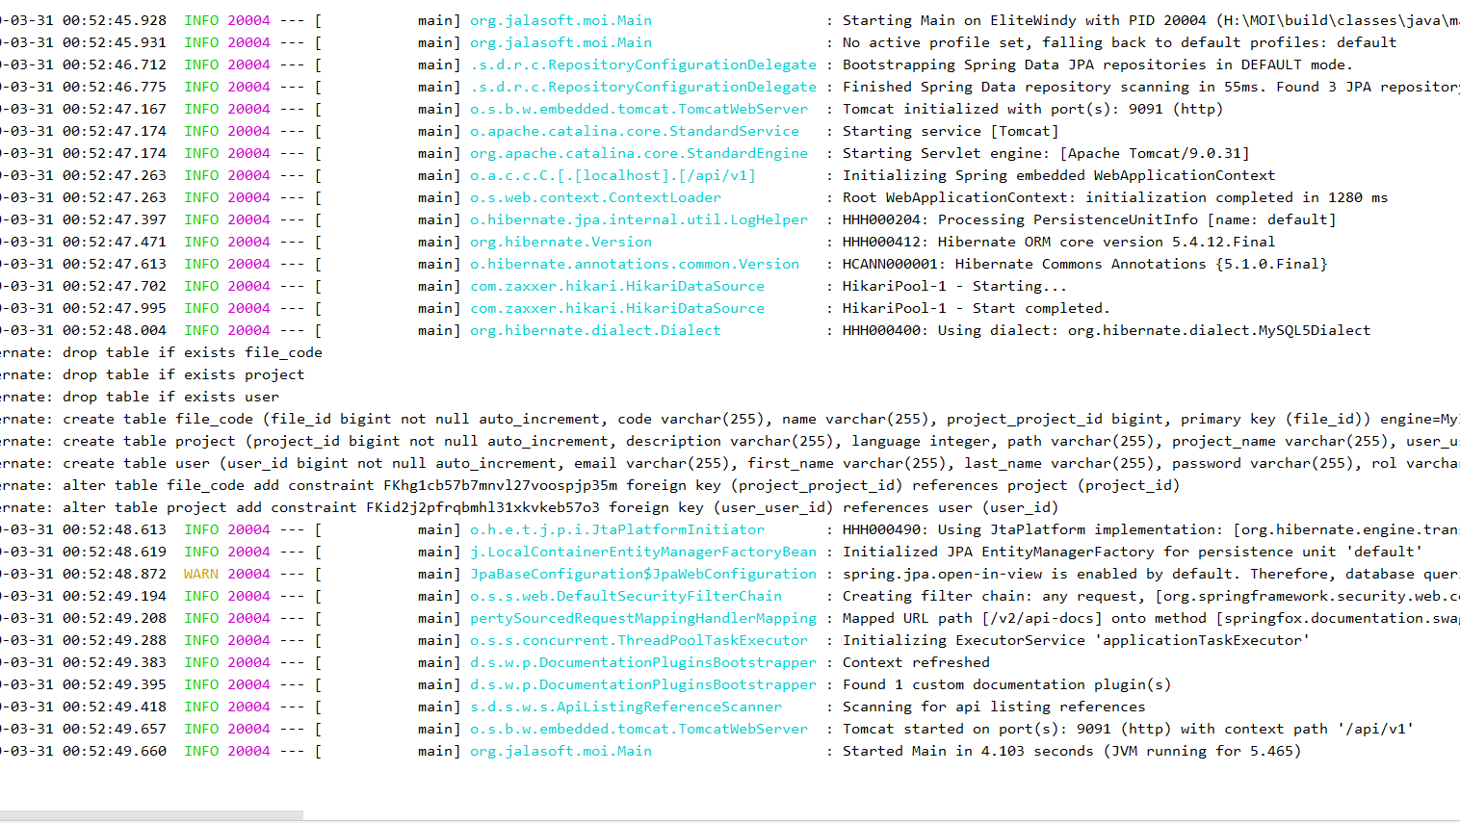
Loggers
Configurable size
Configurable output path
Levels: ERROR, WARN, INFO, DEBUG, and TRACE

Slide 25
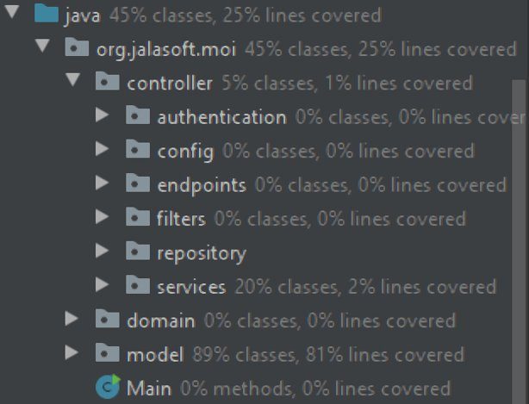
Code coverage (Unit tests)

Slide 26
Show demo
Click here

Slide 27

Known bugs
Make validation when a new file is created with the same name of an existing file.
Validate if a language exists before entering the input.
Validate that names when creating new file have no special characters.
Java need main direction to run.
File is create with the code field null in the database.
Replace a project in the local when a new one is create with the same name.
Error 500 when the client put the wrong data, should be error 400.
Loss data when update an entity if you leave a field empty.

